Slide 1
Solar System and the Universe
Topic 2

Slide 2
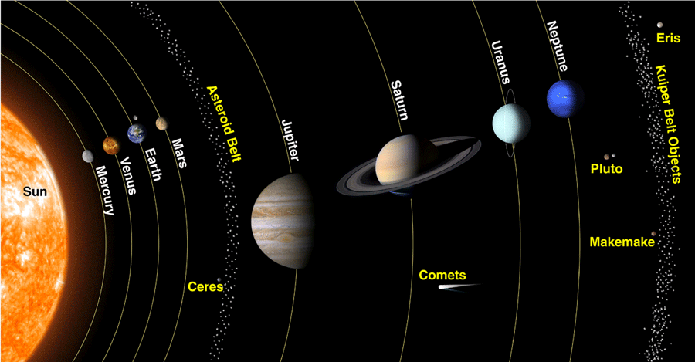
2-1: Solar System Objects
Understanding the Solar System
  The solar system consists of the sun, planets, their moons, and a variety of smaller objects.
  Each object in the solar system has its own unique features
  The sun is at the center of our solar system. Its gravity keeps the other objects orbiting around it.

Slide 3
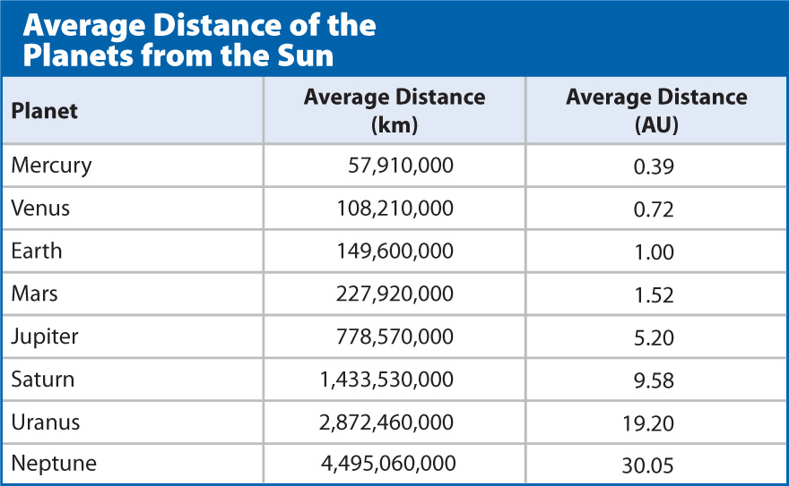
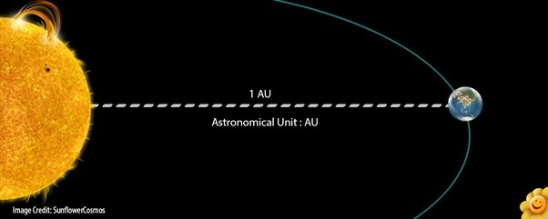
2-1: Solar System Objects
Distances in the Solar System
  Distances in the Solar System are really large
  Scientists use astronomical units, or AUs, instead of meters or kilometers
  One astronomical unit, AU, is the average distance between the center of the sun and the center of the Earth.

Slide 4
2-1: Solar System Objects
Comparing the Sun and the Planets
  Sun
    Gaseous body, creates light and heat
    Largest and most massive object in the solar system
    Average mid-size star
  Planets
    Round body, orbits a star, has cleared out the region along its orbit
    Inner planets
      Closer to the sun, small, made of mostly rock and metal
      Mercury, Venus, Earth, Mars
    Outer planets
      Farther from the sun, large, made mostly of gas and liquid
      Jupiter, Saturn, Uranus, Neptune

Slide 5
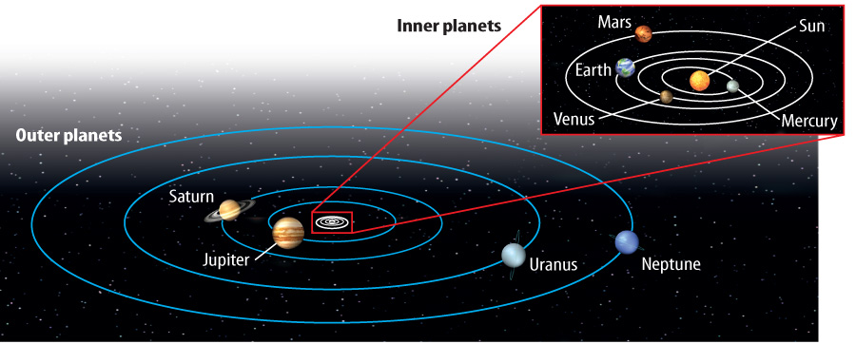

Slide 6
2-1: Solar System Objects
Smaller Solar System Objects
Dwarf planets
  Body that orbits the sun, but has not cleared the area of its orbit
  Pluto, Eris, Ceres, Makemake, Haumea
Moons
  Natural satellites that orbits a planet
  Planets and dwarf planets vary in their number of moons
Asteroids
  Small, rocky bodies; found in the asteroid belt – between Mars and Jupiter
Meteoroids
  Small, rocky bodies; floating through space(can become meteors if entering the Earth's atmosphere)
Comets
  Balls of ice and rock, they have long, narrow orbits around the Sun

Slide 7
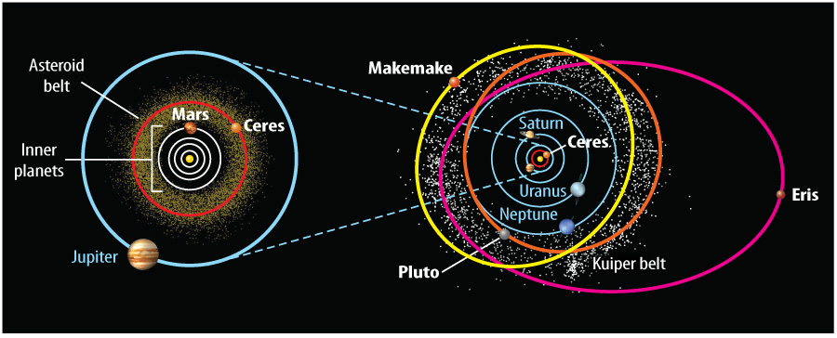

Slide 8
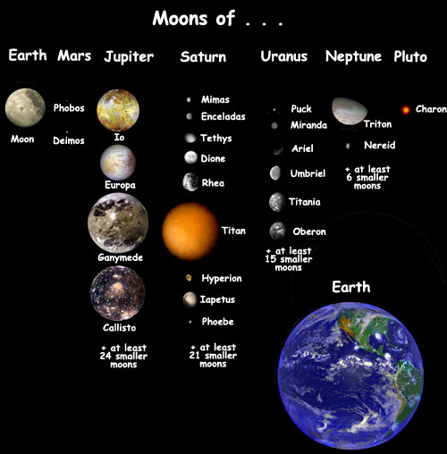

Slide 9
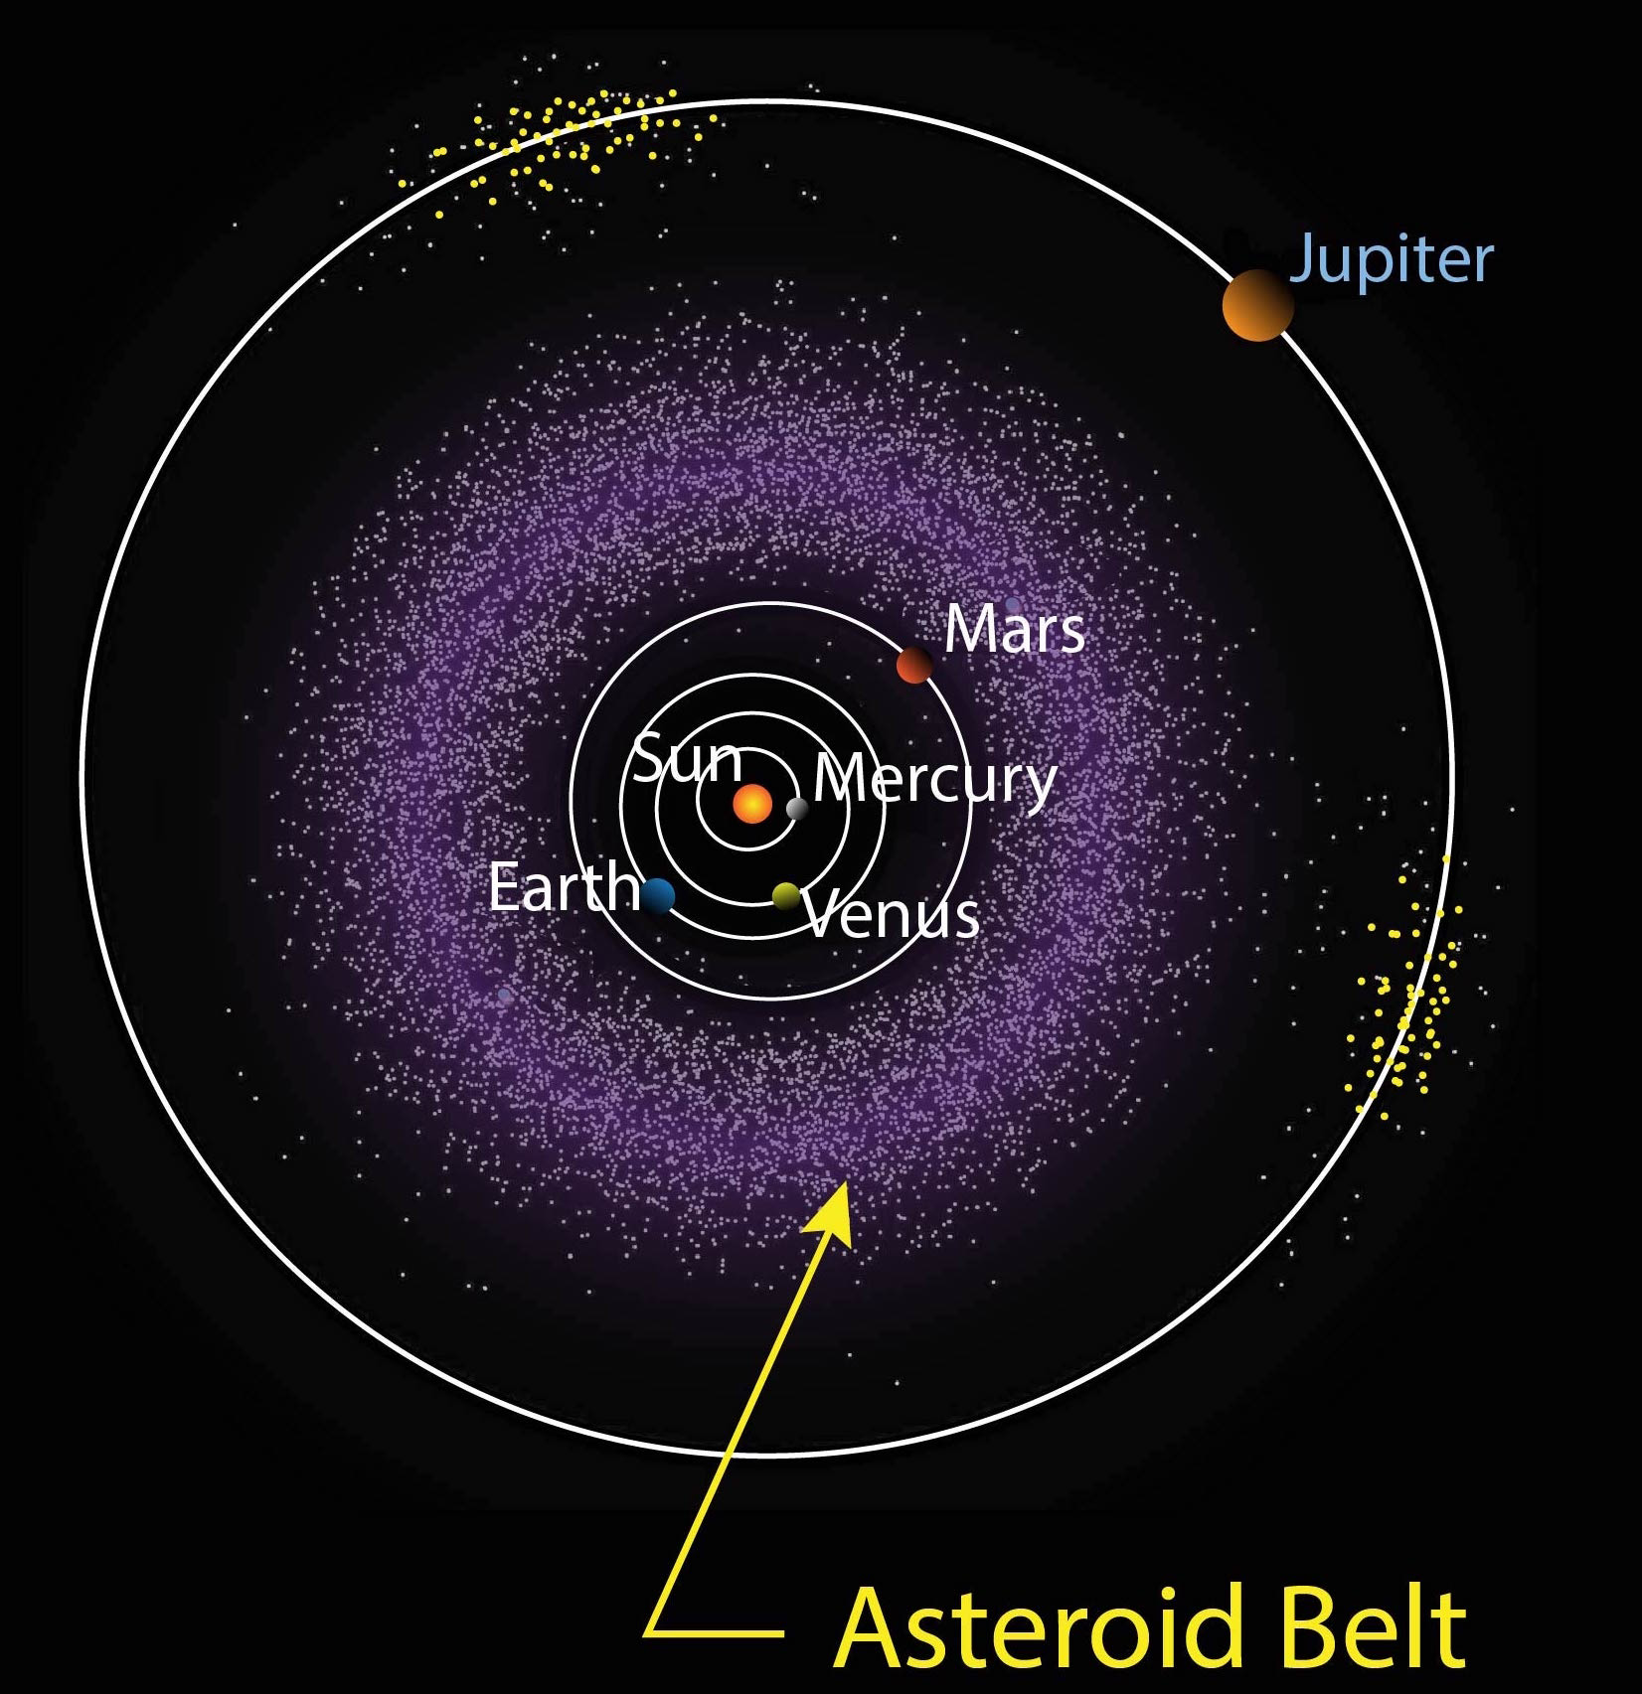
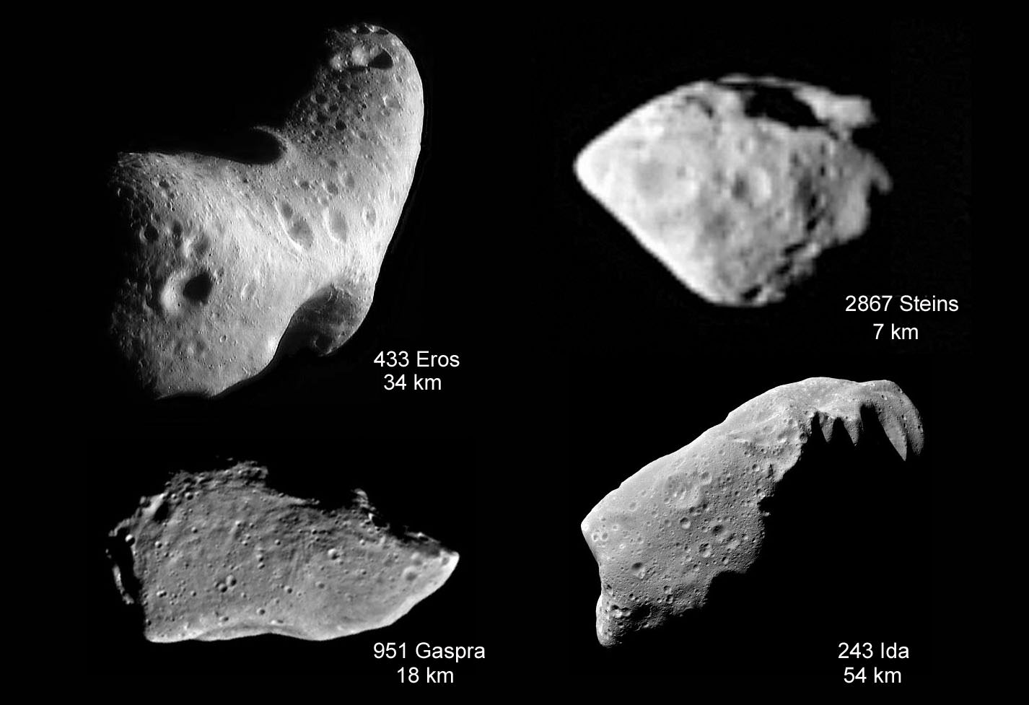

Slide 10
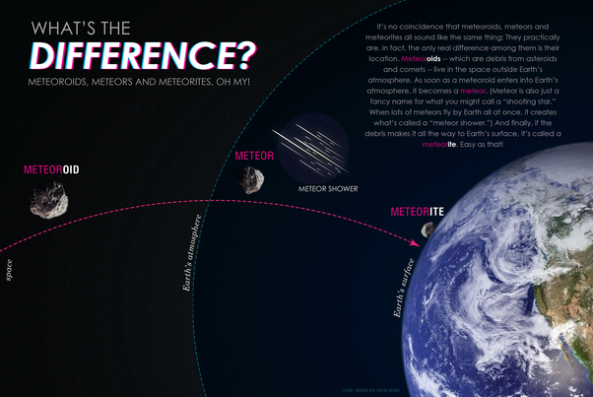

Slide 11
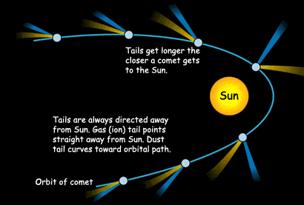
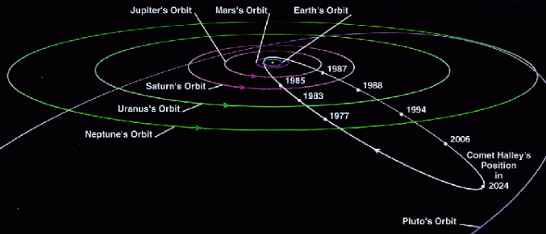

Slide 12
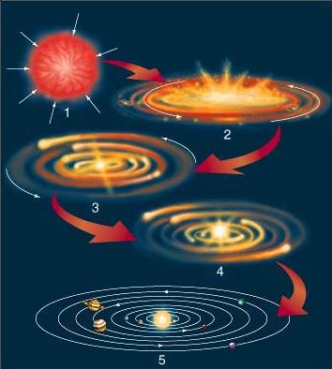
2-1: Solar System Objects
Solar System Formation
  A Disk Forms
    Gravity pulls the materials of the cloud of gas and dust together
    As material is pulled toward the center pressure and temperature increase
    Once temperature was high enough for nuclear fusion, the Sun began to give off heat and light
  The Planets Form
    Around the Sun, rock, ice, and gas are pulled together to form planetesimals
    Inner planets were closer, so mostly small, rocky, and dry, without gas layers
    Outer planets were farther, so mostly big, gas giants

Slide 13
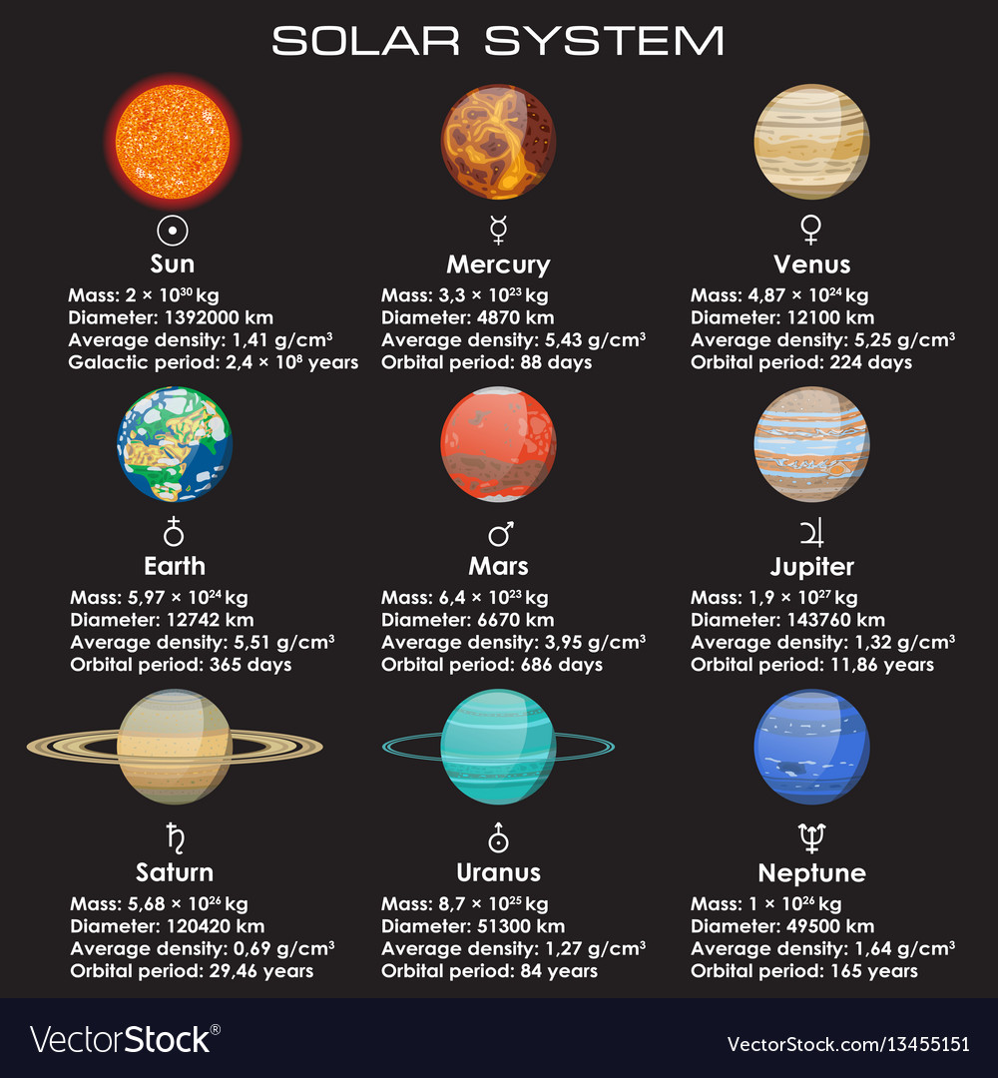
2-1: Solar System Objects
The Planets

Slide 14
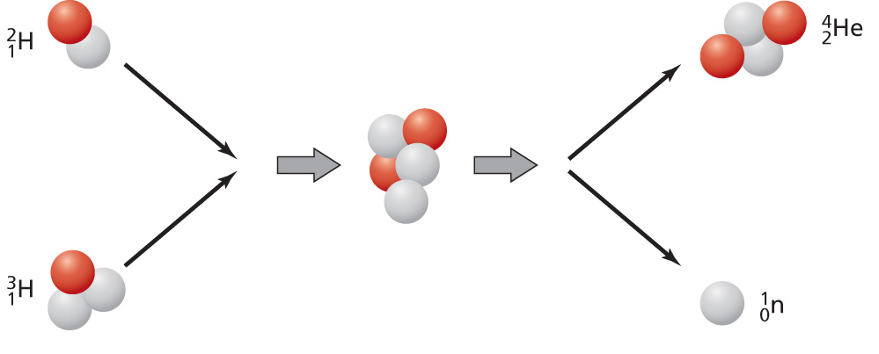
2-2: The Sun
Structure of the Sun
  Large gaseous body, most massive object in the solar system
  Has no solid surface
  Composed of ¾ Hydrogen, ¼ Helium in the form of plasma
  Sun energy comes from nuclear fusion (Hydrogen into Helium)
  Gravity from the Sun keeps planets circling in their orbits

Slide 15
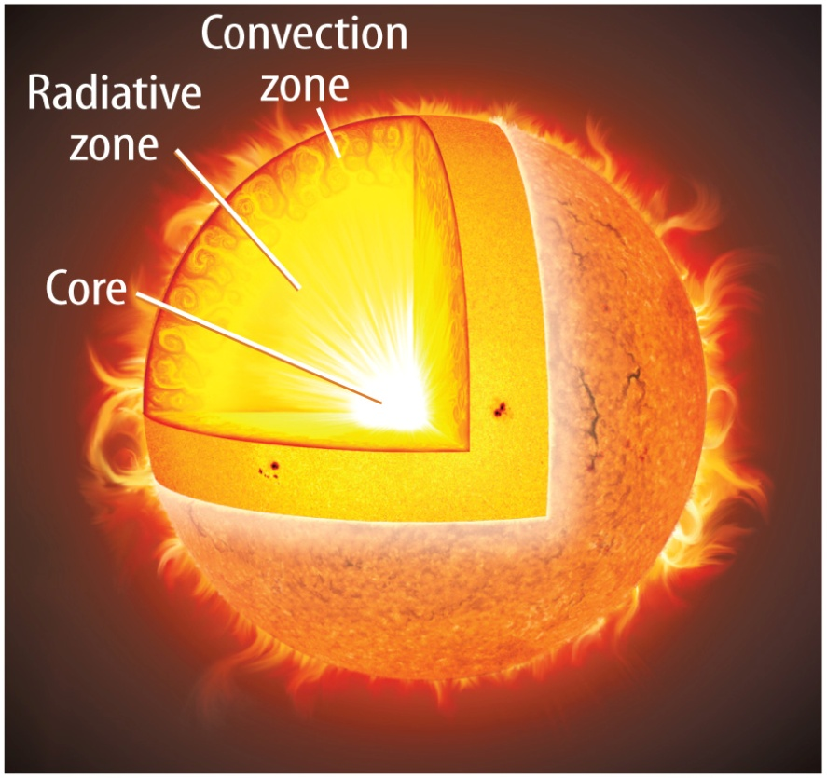
2-2: The Sun
The Sun’s Interior
  The core
    Inner most layer
    High pressure and temperature make fusion possible
    Fusion = Hydrogen fused into helium
  The radiative zone
    Energy leaves the core as electromagnetic radiation
    High density layer
  The convection zone
    Outer most interior layer
    Hot gases move toward the surface as cooler gases move down to the interior

Slide 16
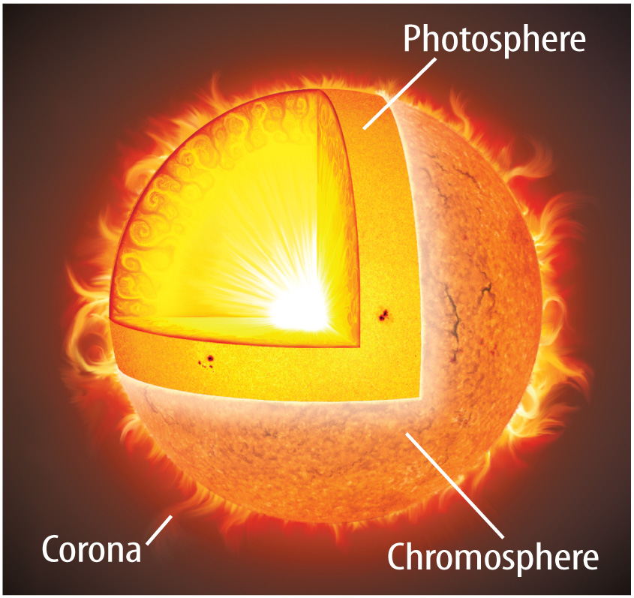
2-2: The Sun
The Sun’s Atmosphere
  The photosphere
    Apparent surface of a star
    Where light energy radiates into space
  The chromosphere
    The orange-red layer
    Above photosphere
  The corona
    Outermost layer
    White halo around the sun
    Streams electrically charged particles called the solar wind

Slide 17
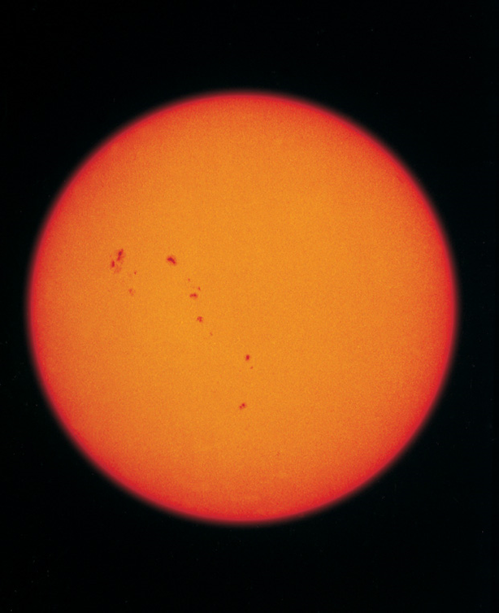
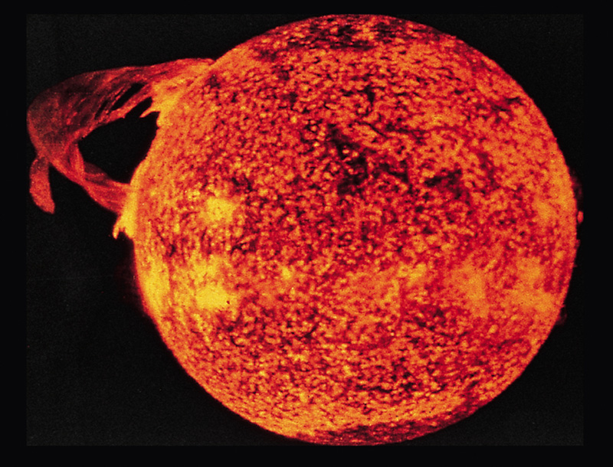
2-2: The Sun
Features of the Sun
  Sunspots
    Cooler areas of plasma than area around them
    Move as the sun rotates
    Number varies every 11 years
  Prominences
    Loops of plasma that link sunspot regions
  Solar flares
    Loops in sunspot regions connect
    Sudden increase in brightness

Slide 18
2-3: Learning About the Universe
Using the Electromagnetic Spectrum
  All objects in space give off electromagnetic radiation
  Astronomers use instruments that can detect electromagnetic radiation
Visible Light
  Light you can see, visible light spectrum (ROY G. BIV)
Other Forms
  Most electromagnetic radiation is invisible to the human eye

Slide 19
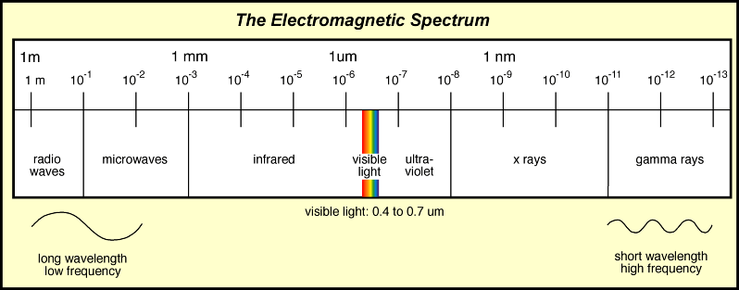

Slide 20
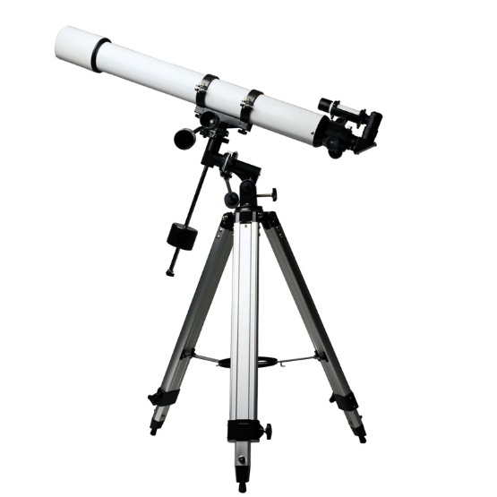
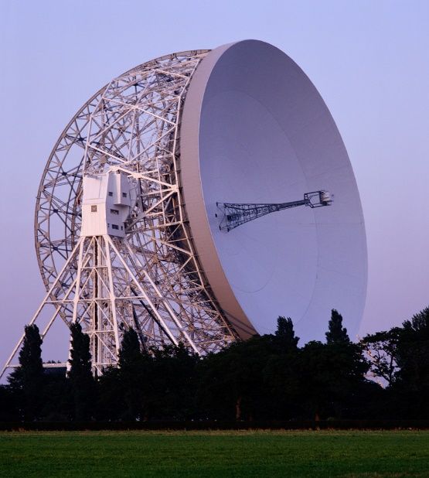
2-3: Learning About the Universe
Optical Telescopes
  Use visible light
  Use lenses or mirrors to magnify and see distant objects
Other Telescopes and Observatories
  Use other forms of electromagnetic radiation
  Radio telescopes
  Infrared telescopes
  X-ray telescopes

Slide 21
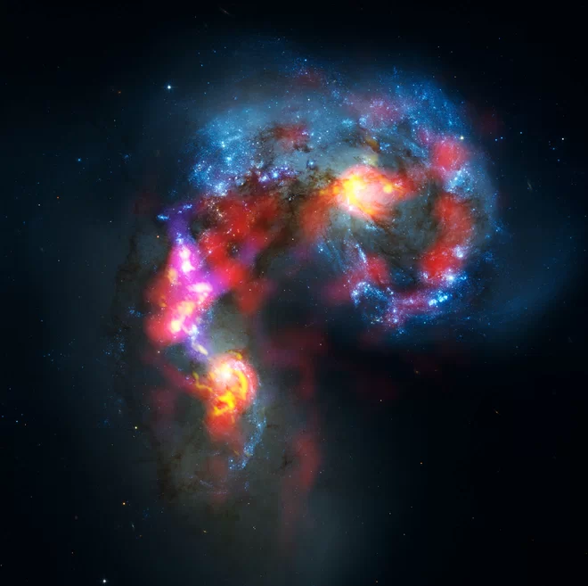
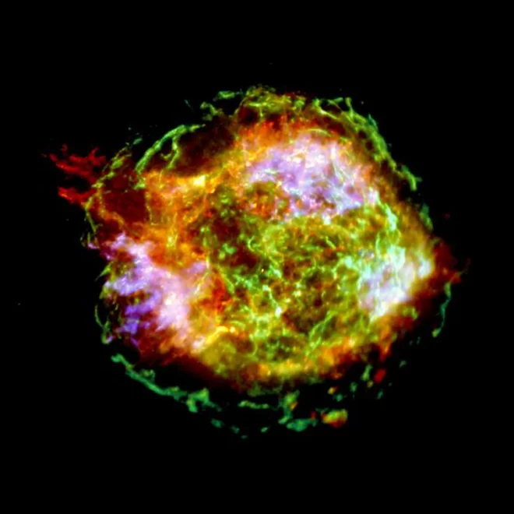
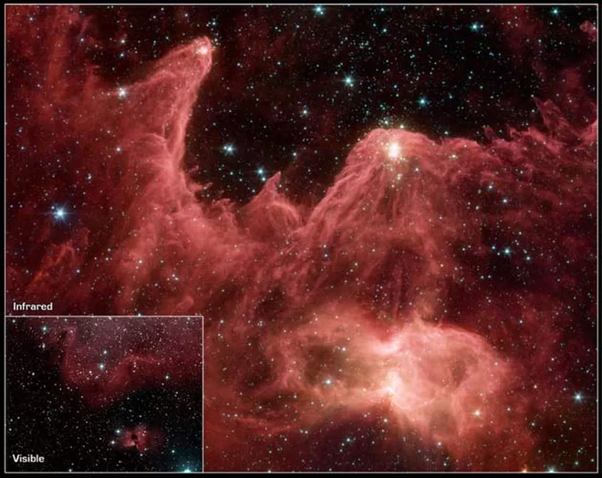

Slide 22
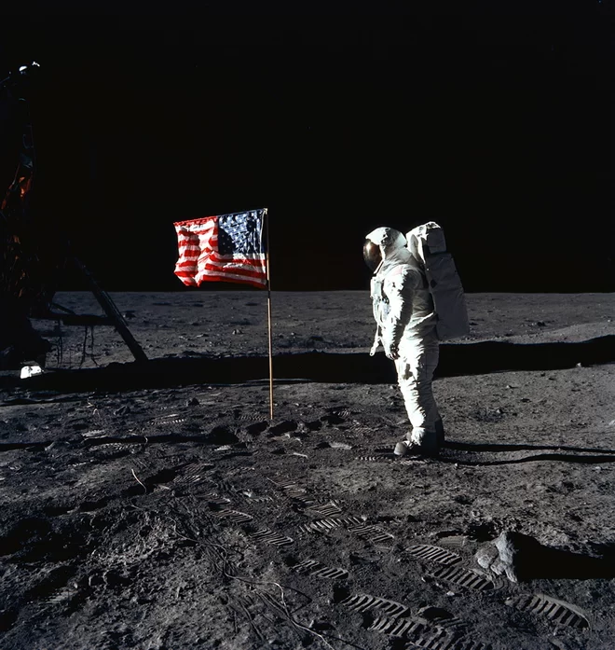
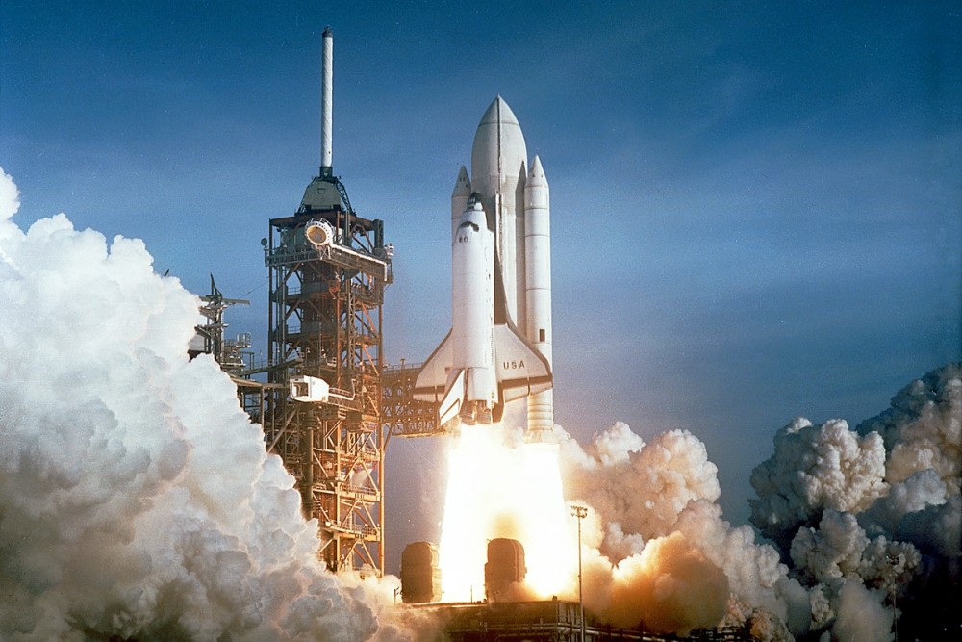
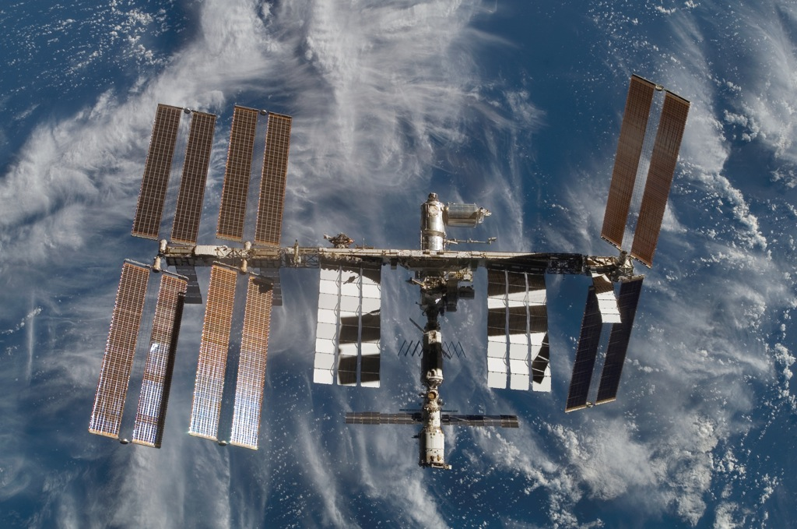
2-3: Learning About the Universe
Exploring Space
  Sputnik – 1957
  Explorer I – 1958
  1st Man to Orbit the Earth - 1961
  Mariner 2 to Venus – 1962
  Moon Landing - 1969
  Skylab – 1973
  Voyager I & 2 – 1977
  The Space Shuttle – 1981
  Hubble Space Telescope – 1990
  Cassini-Huygens – 1997
  International Space Station – 1998
  Mars Exploration – 2003
  Spitzer Space Telescope – 2003
  Voyager 1 Leaves the Solar System – 2012
  Kepler - 2009

Slide 23
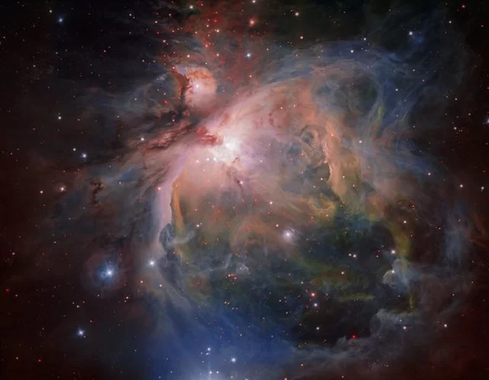
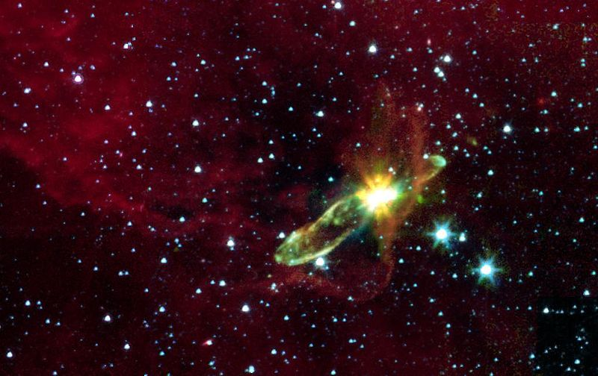
2-4: Stars
Formation and Development of Stars
  Stars form, change over their life span and eventually die
  How long a star lives depends on its mass
  Steps of Star Formation
    Nebula
      Birthplace of stars
      Large cloud of gas and dust, cold
    Protostar
      Gravity pulls the gas and dust into dense parts
      Densest parts start to heat up
      Temperature will continue to increase until nuclear fusion starts

Slide 24
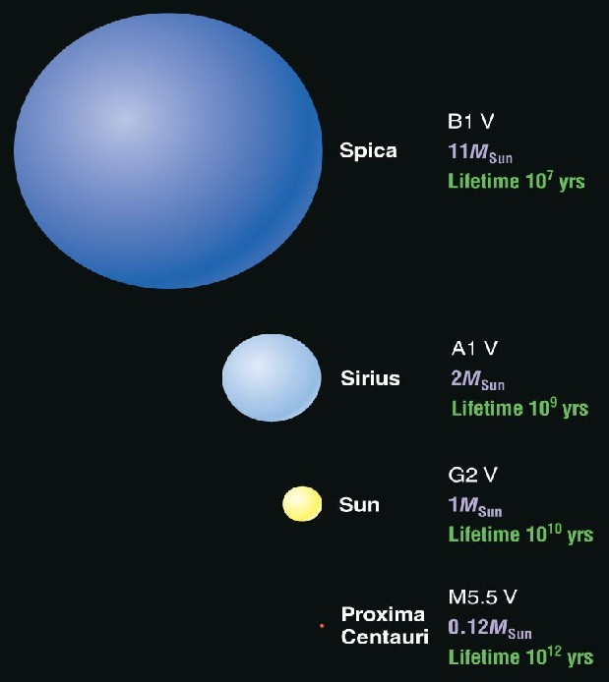
2-4: Stars
Life Span
  Stars enter the Main Sequence once they are able to fuse hydrogen into helium
  How long a star stays on the main sequence is determined by its mass
  More mass = more fuel = longer life span
  Less mass = less fuel = shorter life span

Slide 25
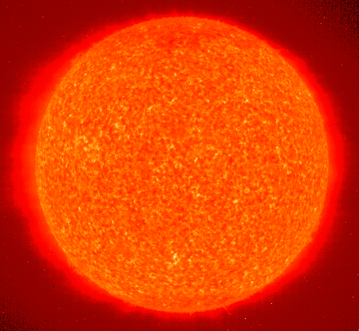
2-4: Stars
Life Span cnt’d
  When a star’s hydrogen supply is nearly gone, the star leaves the main sequence and begins the next stage
  of its life cycle
  Red Giant
    When the star runs out of fuel, gravity makes the core shrink and heat up. The outer layers expand.
    The star will begin to fuse helium into carbon
    The Red giant will collapse and expand again and again as the star tries to fuse carbon, and other elements

Slide 26
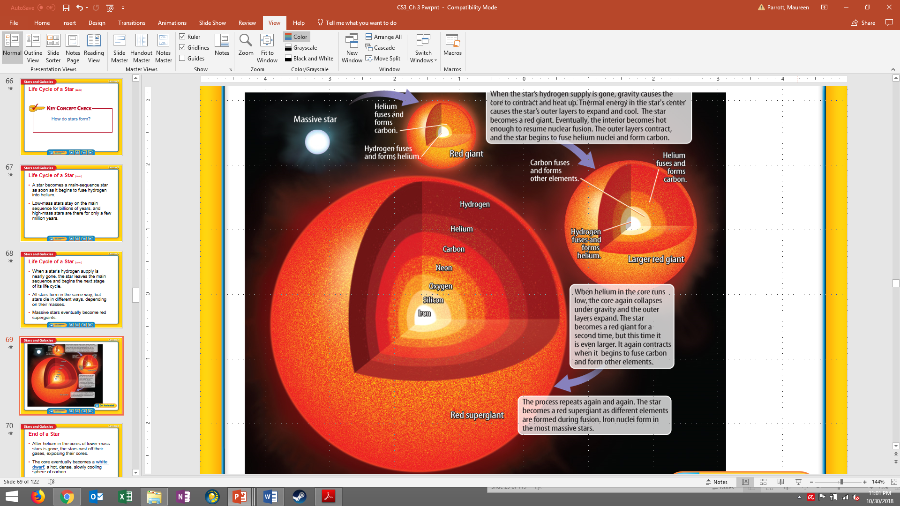

Slide 27
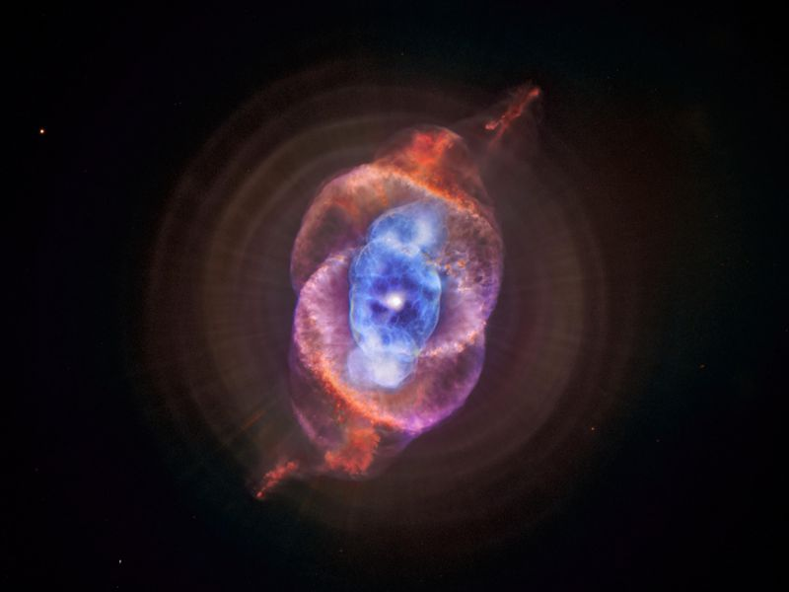
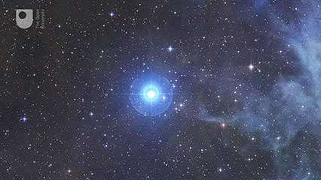
2-4: Stars
Life Cycle Cnt’d
  Low & Medium Mass Stars
    Planetary Nebulas
      Outer layers of red giant expand even bigger
      Layers drift into space forming a glowing cloud of gas
    White Dwarfs
      Once layers of planetary nebula drift away
      Blue-white core of star is left to cool
      White dwarfs are very dense
      After billions of years, the white dwarf will cool to a black dwarf

Slide 28
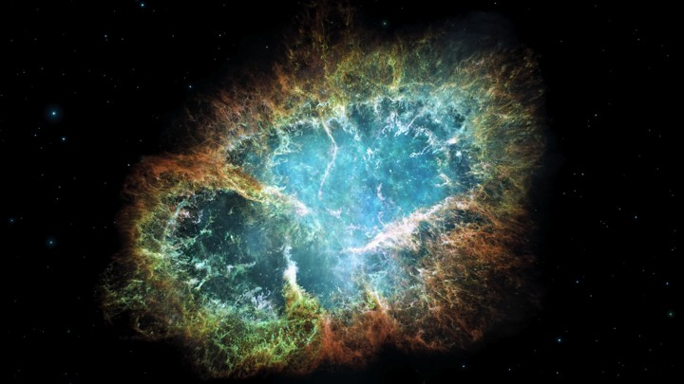
2-4: Stars
Life Cycle Cnt’d
  Massive and Super Massive Stars
    Supernovas
      During red giant stage, massive stars fuse heavier and heavier elements
      After red giant stage, the star collapses under the force of gravity
      This creates an large explosion that creates even heavier elements
      This sends these elements out into the universe

Slide 29
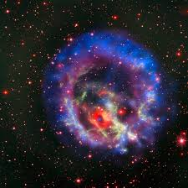
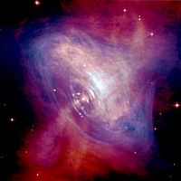
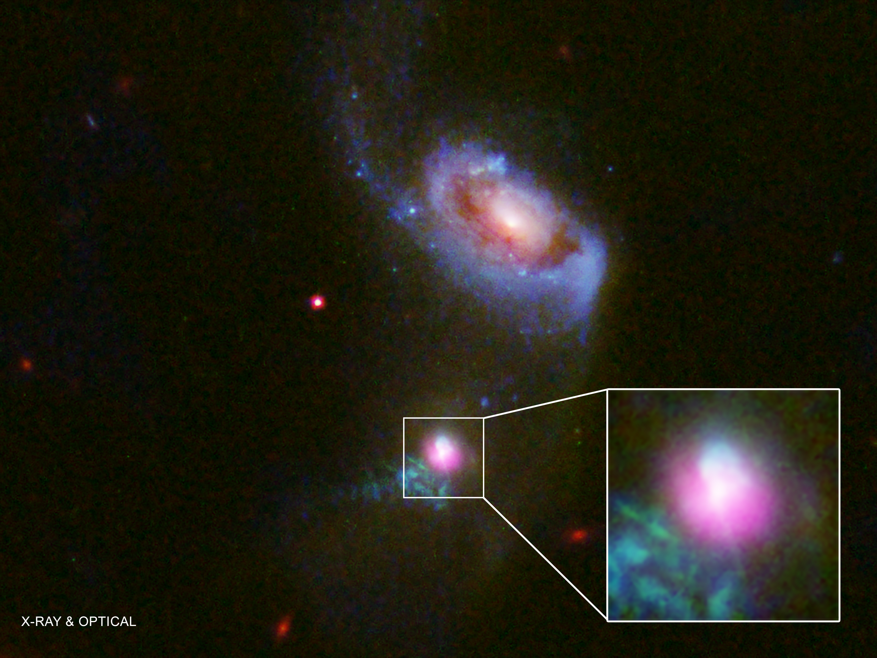
2-4: Stars
Life Cycle Cnt’d
  Neutron Stars
    Some material from the exploding star is left
    Smaller and denser than white dwarfs
  Pulsars
    A spinning neutron star
    Emit radio wave pulses
  Black Holes
    Most massive stars
    An object with gravity so strong that nothing, not even light, can escape

Slide 30
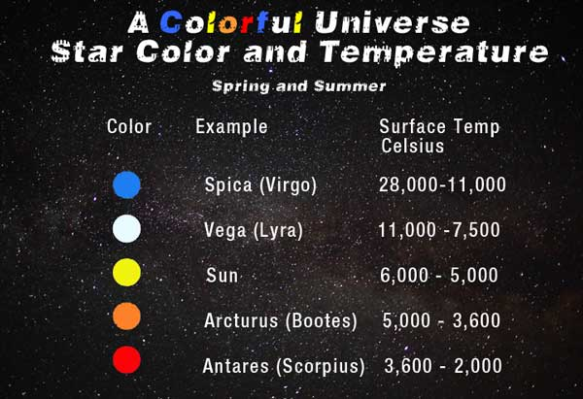
2-4: Stars
Star Properties
  Astronomers classify stars according to their physical characteristics
  Color and Temperature
    Color indicates temperature
    Red
    Yellow
    White
    Blue
  Size

Slide 31
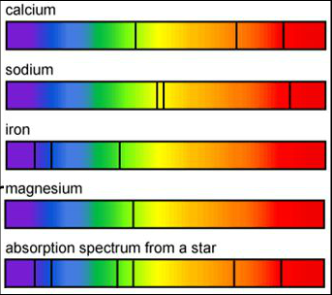
2-4: Stars
Star Properties
  Chemical Composition
    Astronomers use spectrographs to determine what stars are made of
    Spectrograph breaks light into colors (a spectra)
    The spectra pattern is unique to each element and tells what elements are present

Slide 32
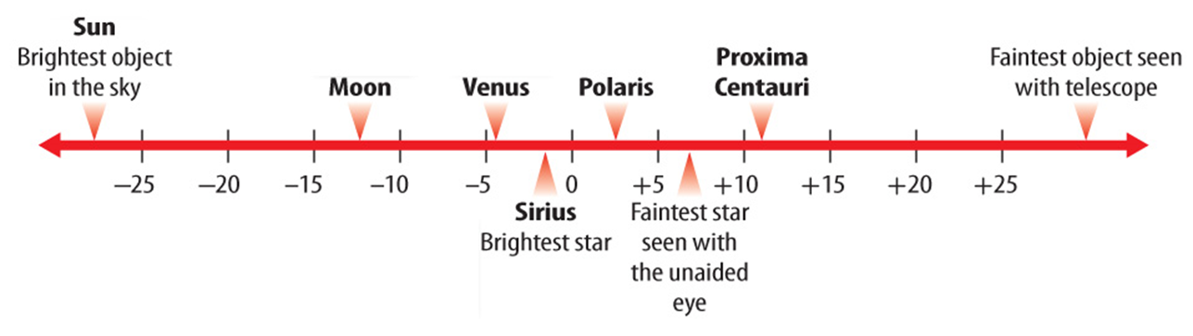
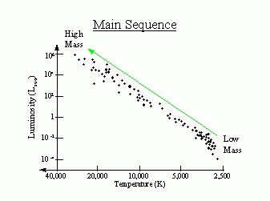
2-4: Stars
Star Properties
  Brightness
    Depends on a star’s temperature
    Apparent Brightness
      Brightness as seen from Earth
    Absolute Brightness
      Is based on temperature of star
  Distance
    How many light years to the star
    Light year is the distance light travels in a year (9.46 trillion kilometers)

Slide 33
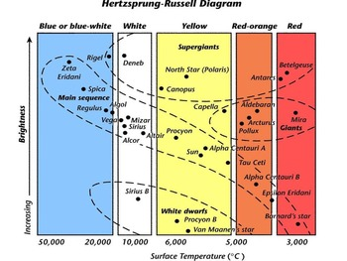
2-4: Stars
Classifying Stars
  Hertzsprung-Russell diagram
  Used to classify and see how stars change over time

Slide 34
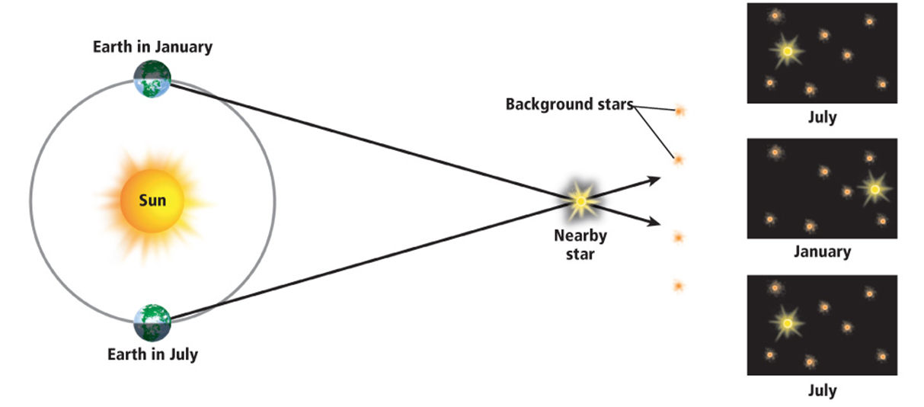
2-5: Galaxies
From Stars to Galaxies
  Parallax
    Apparent motion of a star, as seen from opposite sides of Earth’s orbit
    Used to measure distance to star

Slide 35
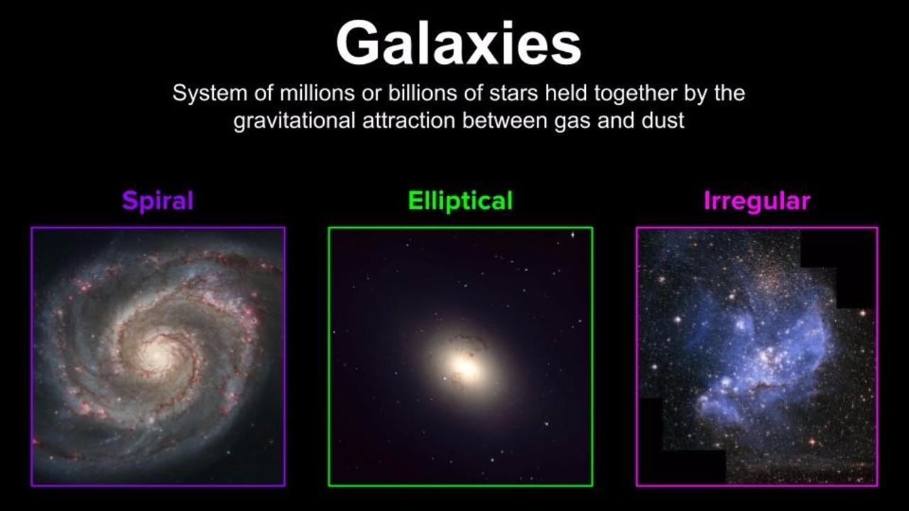
2-5: Galaxies
From Stars to Galaxies Cnt’d
  Star Systems
    Have 2 ore more stars grouped together
    Can be binary, or multiple
  Star Clusters
    Larger groupings of stars
    Formed from the same nebula
  Galaxies
    Group of stars, star systems, star clusters, dust and gas bound by gravity
    Irregular, Spiral, Ellipitical

Slide 36
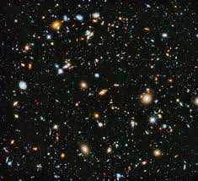
2-5: Galaxies
The Universe
  all of space and everything in it
  Light-years
    Distances between stars are immense
    Light-year = 9.46 trillion kilometers
    Scientific Notation is used to represent very large numbers
  Scale of the Universe

Slide 37
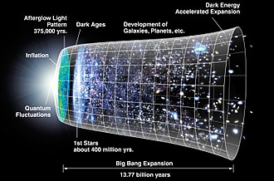
2-5: Galaxies
Understanding the Universe
  The Big Bang
    Universe formed in an instant, billions of years ago, in an enormous explosion
    Supported through evidence of the expanding universe
  The Future of the Universe

